Slide 1
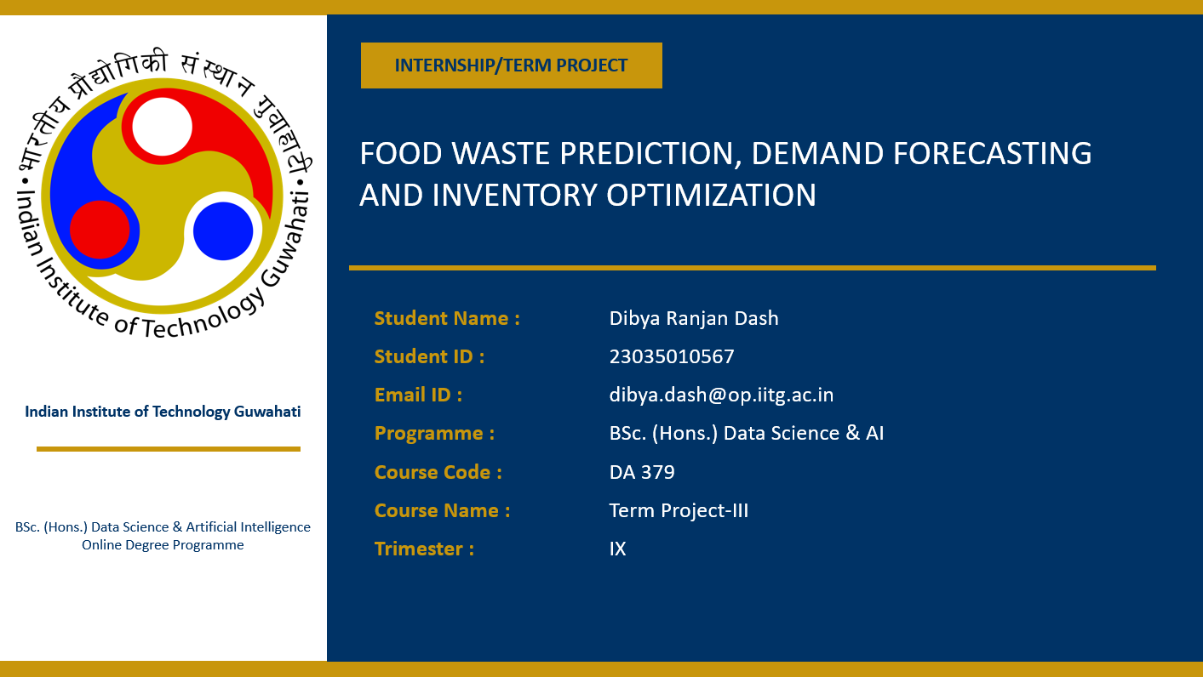
Title Here
Subtitle

Slide 2
Agenda
Introduction
Problem Context
Tools and Technologies Used
Dataset and Data Validation
Source Code
Outputs and Results
Evaluation Metrics
Summary

Slide 3
Introduction
Food waste is a major challenge for restaurants, cafeterias, and food service organizations.
Inaccurate demand estimation often leads to overproduction, inventory inefficiencies, and increased costs.
This project develops an AI-powered platform that predicts food demand, estimates food waste, and generates inventory recommendations.
Machine learning models use historical sales, weather conditions, event information, and operational data to support decision-making.
The system is integrated with a Flask API and Streamlit dashboard for real-time prediction and inventory planning.

Slide 4
Problem Context
Food service organizations must prepare sufficient food to meet customer demand while minimizing waste.
Traditional forecasting methods often rely on manual estimation and experience.
Overproduction increases food waste and operational costs.
Underproduction may result in stock shortages and customer dissatisfaction.
Demand is influenced by weather conditions, holidays, events, and historical consumption patterns.
An intelligent forecasting system can improve planning, sustainability, and profitability.

Slide 5
Tools and Technologies Used
Programming Language: Python
Data Processing: Pandas, NumPy
Machine Learning: Scikit-Learn
Demand Forecasting Model: XGBoost Regressor
Waste Prediction Model: Random Forest Regressor
Model Serialization: Joblib
Backend API: Flask
Dashboard: Streamlit

Slide 6
Dataset and Data Validation
Dataset contains 20,000 records on food preparation, sales, wastage, and related features with behavioral indicators.
Data cleaning involves removing missing and duplicate records, validating dates, and encoding categorical variables.
Business rules ensure sold and wasted quantities do not exceed prepared quantities, maintaining data integrity.
Outliers are detected using interquartile range method; cleaned records are sorted chronologically and exported.

Slide 7
Source Code
Data Validation Pipeline cleans the dataset by handling missing values, removing duplicates, validating dates, enforcing business rules, and detecting outliers.
Inventory Optimizer analyzes predicted demand and waste to recommend inventory levels, safety stock, procurement needs, cost-saving opportunities, and waste-reduction strategies.
Machine Learning Models uses XGBoost for demand forecasting and Random Forest for food waste prediction, with temporal feature engineering to capture demand patterns.
Flask API enables real-time predictions and inventory recommendations.
Streamlit Dashboard provides an interactive interface to visualize forecasts, optimization reports, risk levels, and actionable insights.

Slide 8
Outputs and Results
The platform forecasts food demand and waste to optimize inventory and reduce unused food.
Inventory levels and procurement needs are calculated by combining demand, waste, and safety stock.
The platform quantifies cost losses from waste and identifies savings through improved planning.
Waste-based risk levels guide prioritization; insights are presented via a Streamlit dashboard.

Slide 9
Evaluation Metrics
Mean Absolute Error measures average prediction errors, indicating model accuracy and forecasting reliability.
R-squared evaluates variance explained by the model, indicating predictive power and relationship strength.
Real-world assessment compares predictions to historical sales, weather, and operations to ensure business relevancy.
Evaluation supports continuous model improvement through parameter tuning and feature selection for accuracy.

Slide 10
Summary
Developed an AI-powered system for food demand forecasting, waste prediction, and inventory optimization.
Integrated ML models, Flask API, and Streamlit dashboard for real-time decision support and waste reduction.
Key Takeaway
Machine learning can significantly improve food inventory planning, reduce waste, lower costs, and support sustainable food service operations.
Future Work
LSTM-based demand forecasting.
Multi-location inventory optimization.
Real-time POS and IoT integration.
Cloud deployment and mobile accessibility.

Slide 11
Thank You
https://github.com/dibyardash/Food-Waste-Prediction-Demand-Forecasting-and-Inventory-Optimization.git

